Slide 1
Police Department
Larry Gonzalez
Deputy Chief

Slide 2
Officer Involved shooting P18-044194
Date: March 8, 2018
Time: 1735 Hours
RSO: JV180670133
Location: 9931 Willowbrook Rd.
Jurupa Valley, CA 92509

Slide 3
Officers
Officer Wright – Approximately11 years as a sworn police officer. Full time METRO team for about two years.
Officer Soria - Approximately 10 years as a sworn police officer. Full time METRO team for about two years.

Slide 4
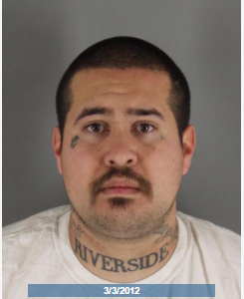
Suspect Ernie David Saldivar - 31

Slide 5
Suspect
Saldivar had an extensive criminal history and was a documented Eastside Riva gang member. He had prior convictions for robbery, possession of illegal weapons, possession of a controlled substance, resisting arrest, evading a police officer, being a felon in possession of a firearm, and gang enhancements. Saldivar was on parole for being a convicted felon in possession of a firearm.

Slide 6
Overview
On August 26, 2017, Saldivar and his ex-girlfriend were involved in an altercation to the front of Saldivar’s home located at 4251 Langston St. located in the City of Riverside.
As she was attempting to leave the location, Saldivar fired at least one shot from a handgun that struck her vehicle. She believed Saldivar had fled the location on foot.
The ex-girlfriend stopped her vehicle and went into the home to call 911. While she was inside Saldivar returned to the location, took the phone from her, and broke it.

Slide 7
Overview
Saldivar left the location. The ex-girlfriend was able to report the crime to the Riverside Police Department.
Officers were unable to locate Saldivar on the night of the incident. The Gang and METRO units had been actively looking for Saldivar.
On March 8, 2018, the METRO unit learned that Saldivar may be staying at the home located at 9931 Willowbrook Rd.
The METRO surveillance officers saw Saldivar in the home’s garage.

Slide 8
Overview
When the METRO officers attempted to contact Saldivar in the garage an officer involved shooting occurred.
Saldivar was in possession of a semi-auto handgun.
No one else was injured during the incident.
The Riverside County Sheriff’s Department is conducting the investigation into the shooting.

Slide 9
9931 Willowbrook Rd.

